Slide 1

Discovering the Impact of Social Media Sentiment on the Covid-19 Infection Rate Using Machine Learning
Final Presentation
Kyler Kang

Slide 2



User Sentiment Around Covid-19
600k+ deaths worldwide
Predicted 100k cases a day (US)
Impact of User Sentiment
Lecture 1.1
Kyler Kang
6: Final Presentation

Slide 3
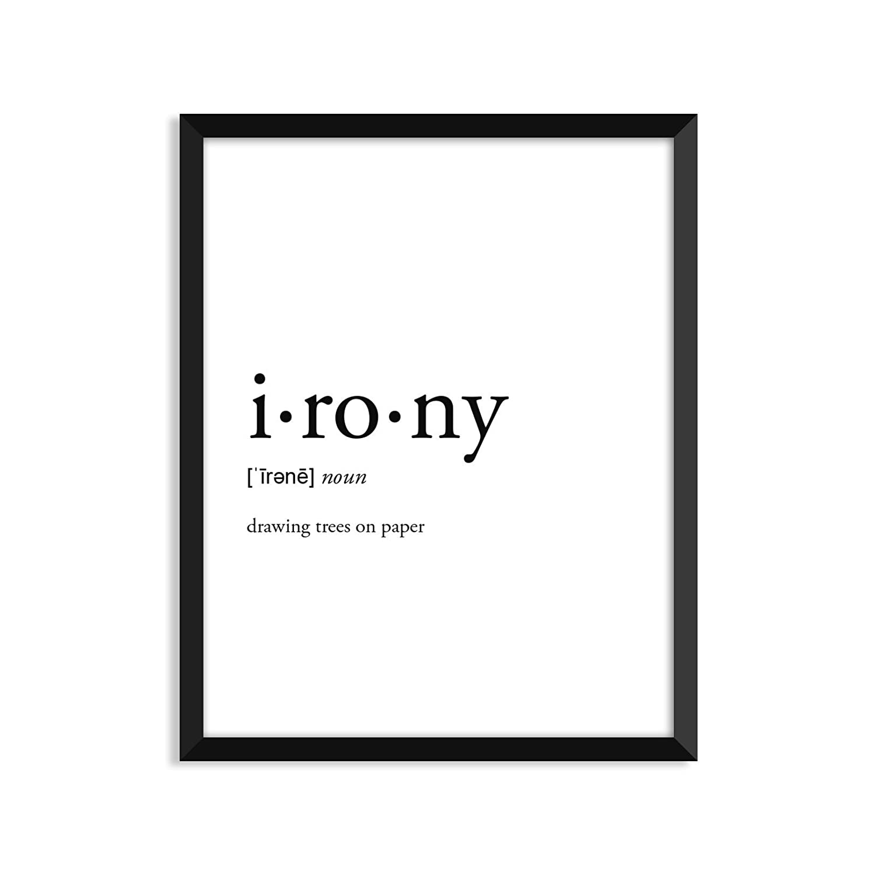
Related Works
Sentiment Analysis in different fields
Stock Market, customer reviews, etc
Algorithm for Sentiment Analysis
Reveals Limitations
Lecture 1.1
Kyler Kang
6: Final Presentation

Slide 4
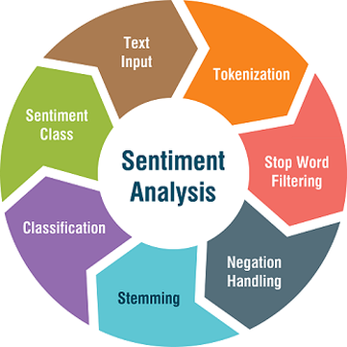
A Sentiment Analysis Approach
Figure 1. A diagram representing an approach to sentiment analysis.
Lecture 1.1
Kyler Kang
6: Final Presentation

Slide 5
Purpose
Does user sentiment impact Covid-19 infection rate?
Inform the public on the impact of social media sentiment
Accurately portray user sentiment on social media
Lecture 1.1
Kyler Kang
6: Final Presentation
Notes:
Question as a purpose, make more clear

Slide 6
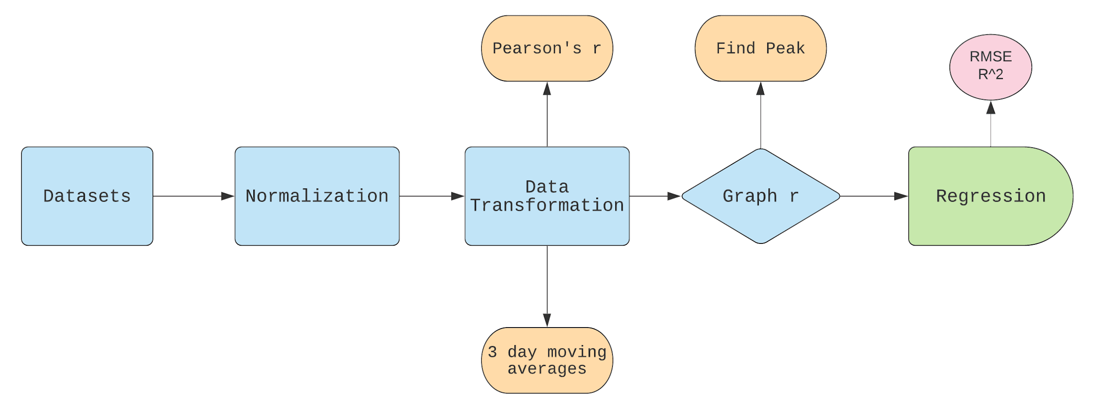
The Process
Lecture 1.1
Kyler Kang
6: Final Presentation

Slide 7
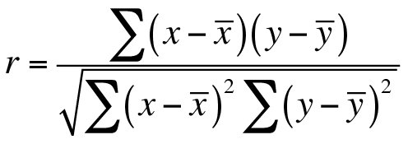
Pearson’s r
Analyze correlation after data is shifted
Daily Covid-19 cases
Mean
Number of negative tweets
Lecture 1.1
Kyler Kang
6: Final Presentation

Slide 8
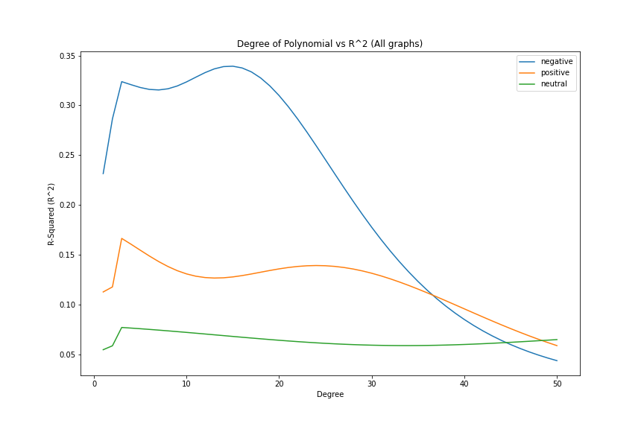
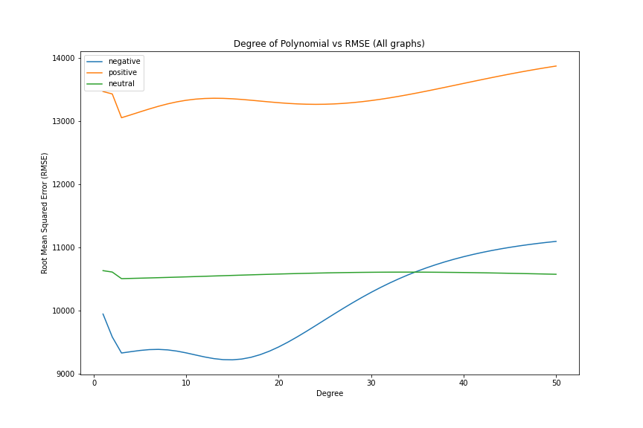
Degree of Polynomial vs. R^2 / RMSE
Figure 2. The change in R^2 as the degree of polynomial increases from 1 to 50. Each line represents a different graph.
Figure 3. The change in RMSE as the degree of polynomial increases from 1 to 50. Each line represents a different graph.
Lecture 1.1
Kyler Kang
6: Final Presentation

Slide 9
Results (Regression)
Best fit: 3rd degree polynomial
Low RMSE, high R^2
High degree vulnerable to overfitting
Lecture 1.1
Kyler Kang
6: Final Presentation

Slide 10
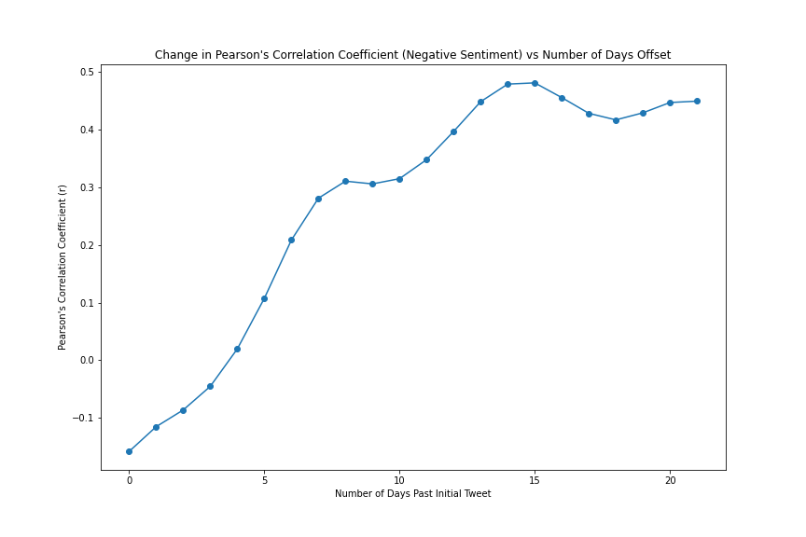
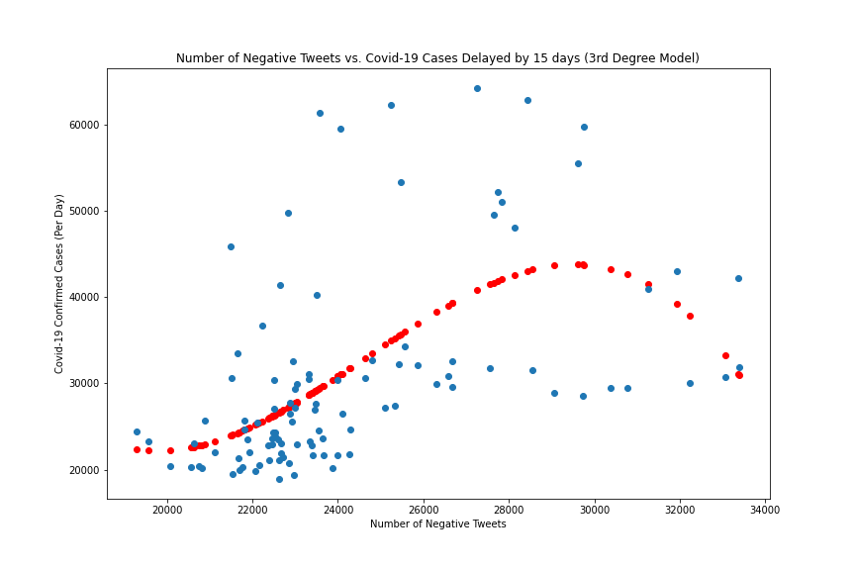
Negative Tweets vs. Infection Rate (Delay)
Figure 4. The change in correlation for negative tweets vs. infection rate as the number of days offset is increased
Figure 5. Negative tweets vs. infection rate after a delay. The red dots represent the 3rd degree model that best fits the data.
Lecture 1.1
Kyler Kang
6: Final Presentation
Notes:
Slow down on graphs, less details on slides

Slide 11
Analysis (Negative Tweets)
Peak in correlation (0.481) at 15 days after Initial Tweet
Takes on average 2-14 days to show symptoms
RMSE of 9311, R^2 of 0.32
Shows correlation, but hard to predict
Lecture 1.1
Kyler Kang
6: Final Presentation
Notes:
Lessen the amount of text on results slides

Slide 12
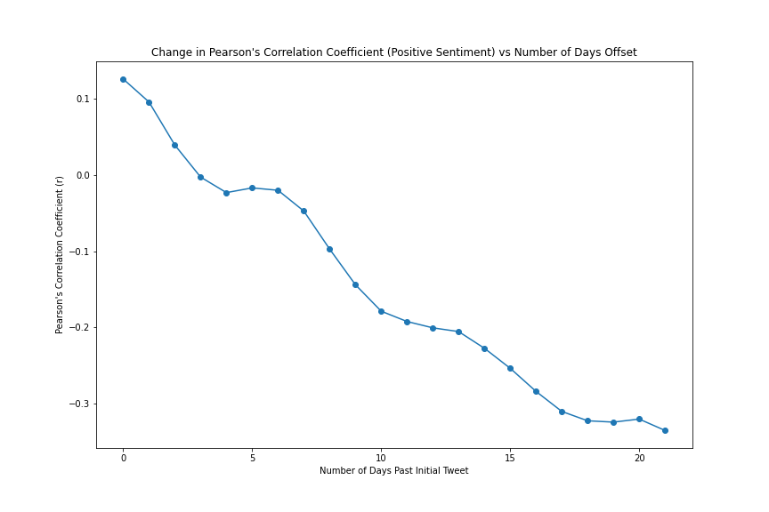
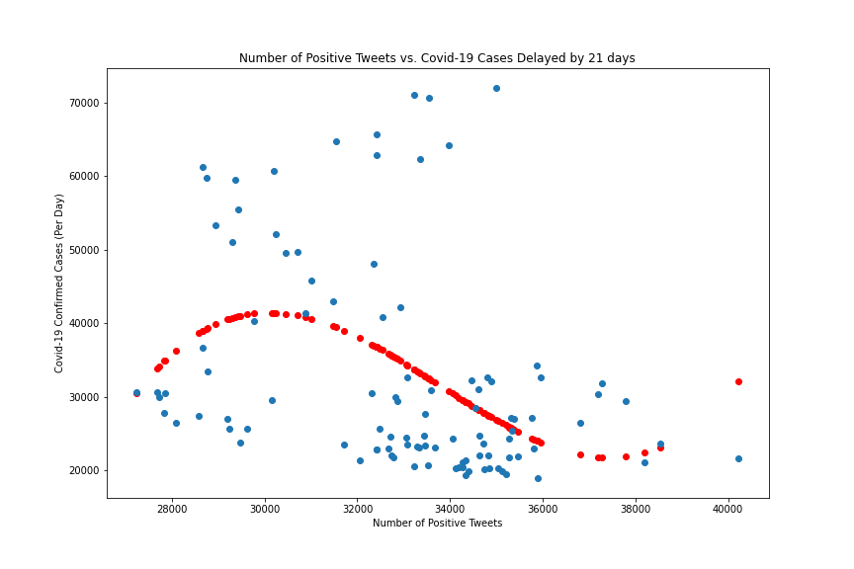
Positive Tweets vs. Infection Rate (Delay)
Figure 6. The change in correlation for positive tweets vs. infection rate as the number of days offset is increased
Figure 7. Positive tweets vs. infection rate after a delay. The red dots represent the 3rd degree model that best fits the data.
Lecture 1.1
Kyler Kang
6: Final Presentation

Slide 13
Analysis (Positive Tweets)
Peak in negative correlation at 21 days
Positive sentiment = decrease in cases
RMSE of 13055, R^2 of 0.17
High error - Low accuracy
Lecture 1.1
Kyler Kang
6: Final Presentation

Slide 14
The Impact of Negative Tweets
Negative tweets correlate strongly with infection rate
15 days after tweet
Don’t let words dictate actions that endanger other
Future
Location
Sentiment Analyzers
Lecture 1.1
Kyler Kang
6: Final Presentation

